Slide 1









Whiteboardmaths.com
7
2
1
5
© 2004 All rights reserved

Slide 2



Perimeter
The perimeter of a shape is the distance around the outside.
Rectangles
15 m
Length
5 m
5 m
Width
15 m
Perimeter =
15 m
+ 5 m
+ 15 m
+ 5 m
= 40 m

Slide 3
Example
Essential working
4 cm
Perimeter = 4 + 7 + 4 + 7 = 22 cm
Perimeter = 8 + 14 = 22 cm
7 cm
Perimeter = 2 x 11 = 22 cm
Perimeter = 2 x 4 + 2 x 7 = 22 cm
Discuss these different ways of showing your method. Can you think of any others?

Slide 4

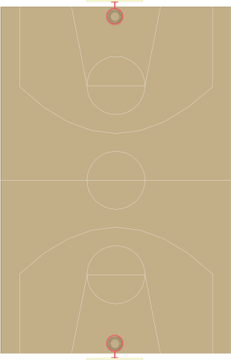
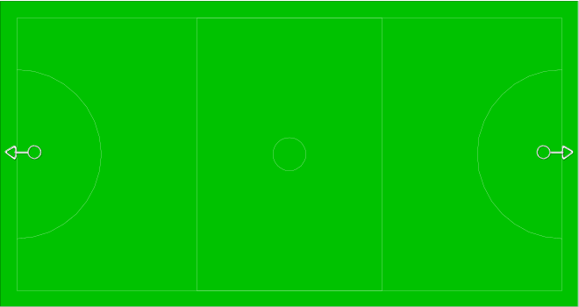
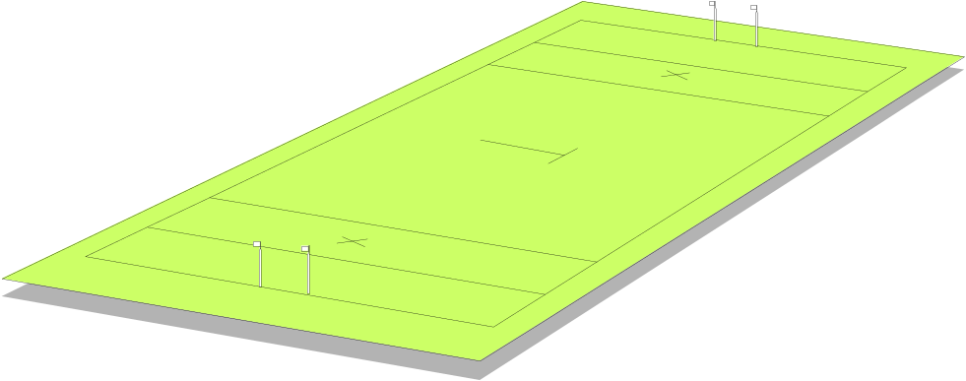

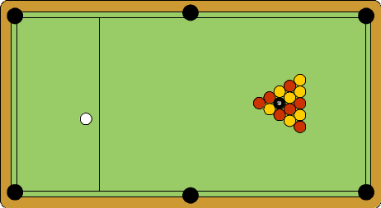
Find the perimeter of each rectangular shape below.
1
100 m
2
50 m
90 feet
280 ft
300 m
40 m
50 feet
3
120 m
4
8½ cm
600 cm = ?
5
320 m
5½ cm
90 cm
28 cm
Not to scale.
210 cm

Slide 5

Find the perimeter of the shapes below.
7 cm
Square
5 cm
6 cm
Regular Quadrilateral
Regular Pentagon
Regular Hexagon
P= 4 x 5 = 20 cm
P= 5 x 6 = 30 cm
P= 6 x 7 = 42 cm
3 mm
3 mm
10 mm
Diagrams not to scale
6 mm
7 mm
3 mm
3 mm
4 mm
9 mm
Irregular Quadrilateral
Irregular Pentagon
P= 3 + 3 + 4 + 6 = 16 mm
P= 3 + 10 + 3 + 7 + 9 = 32 mm

Slide 6

Perimeter of Compound Shapes
4m
Diagrams Not to scale
?
1m
?
3m
4m
3m
?
3m
4m
Perimeter =
4 m +
4 m +
7 m +
3m +
3m +
1m +
= 22m

Slide 7


Perimeter of Compound Shapes
8 m
Not to scale
2 m
2 m
?
5 m
5 m
2 m
2 m
?
4 m
Perimeter =
2 m +
2 m +
5 m +
4 m +
2 m +
2 m +
5 m +
8 m
= 30 m

